Slide 1
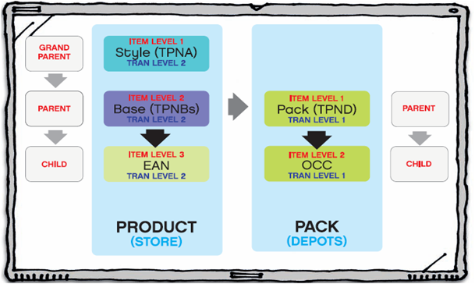









Product Setup
Price Change
Supplier Deals
Clearance
ORIB Training - Advanced
By –
RK

Slide 2
ORIB Overview - Topics
1. What is ORIB and why required?
2. ORIB Architecture
3. Outbound Eway
4. Inbound Eway
5. TAFR Adapter
6. RIB for RPM & RPM Integration
7. Build or Customize new Eways
8. How/where to check Log files
9. RIB message table check

Slide 3
ORIB (Oracle Retail Integration Bus)
ORIB as part of the Oracle Retail solution are responsible for synchronizing data between Oracle Retail applications like ORMS, ORWMS, ORPM and SIM and also legacy systems and third party applications
ORIB synchronises data asynchronously
  Messages will be published in JMS (Java Messaging Service) topic and subscribers will subscribe the messages from JMS Topic.
  Retek 12 version uses Seebeyond e*Gate(ver 5.0.5) EAI platform for storing messages into JMS topic.

Slide 4
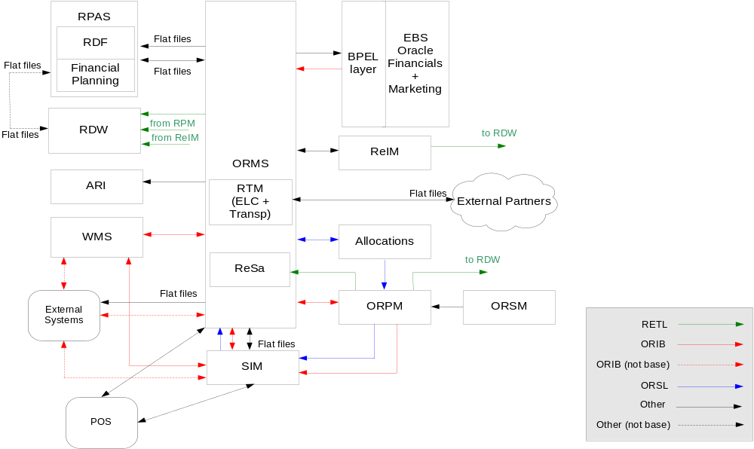
Oracle Retail architecture

Slide 5
Seebeyond e*Gate Components
Registry - A Registry is a file-based database defining the deployed EAI system and a program that controls access to this database. A Registry is organized into one or more Schemas. This also contains basic security objects that control user identifications, roles, and privileges shared across all schemas.
Schemas - Each schema details a collection of e*Ways, Intelligent Queue Managers, Intelligent Queues, Connection Points, and Collaboration Brokers along with their network addresses or locations.
Control Brokers - The control broker is responsible for maintaining the operational control and status of its attached components. Another goal of a control broker is to minimize the number of network connections to the registry and to provide a central point of control for a set of components. Each control broker connects to one registry but can also fail over to other registries if needed.

Slide 6
Seebeyond e*Gate Components - contd
Events and Event Type Definitions- SeeBeyond “events” include both messages passing to and from JMS, and stored procedure calls to external application APIs. An event’s type determines its logical name, but the rules for parsing are determined by an event type definition (ETD). Hence, the ETD has a strong coupling with the message structure.
Collaborations - Collaborations define message processing logic on a per Message Family/message source/ component combination. This logic is “triggered” or executed when the adapter pulls a message with the correct event type from the specified source.
e*Ways – This adapter produce, consume, or otherwise process messages. e*Ways contain one or more “Collaborations” that are triggered from some event. A collaboration works on a collection of input and output events, which may be messages going to or from queues.

Slide 7
Seebeyond e*Gate Components - contd
JMS Intelligent Queues - Java Messaging Service (JMS) IQ hold published messages and maintain a record of what subscribers have received the messages.
JMS IQ Managers - The JMS Intelligent Queue Manager serves two roles. To control a set of Intelligent Queues for any SeeBeyond e*Way. The second (which the RIB uses) is to act as a Java Message Service (JMS) provider, accessible through JMS Connection Points. The RIB is designed to only retrieve and publish messages to a JMS compliant server. The preferred JMS implementation is the SeeBeyond’s standard JMS implementation. The RIB uses JMS topics instead of queues to allow all subscribers to the topic to receive a copy of the message depending on the matching of the subscriber’s message selector and message’s properties.
e*Way Connection Points – An “e*Way Connection” or “Connection Point” defines a session between the e*Way and an external system. The following types of connections are available:
- Java Message Service – a connection to a JMS Server or JMS Service.
- A relational database, such as Oracle
- A TCP/IP connection to a remote application using the HTTP or HTTPS protocol.
- E-mail (uses standard SMTP for outbound and POP3 interfaces for inbound messages)
A database connection point used within a collaboration defines the login, password, and server address for database operations.

Slide 8
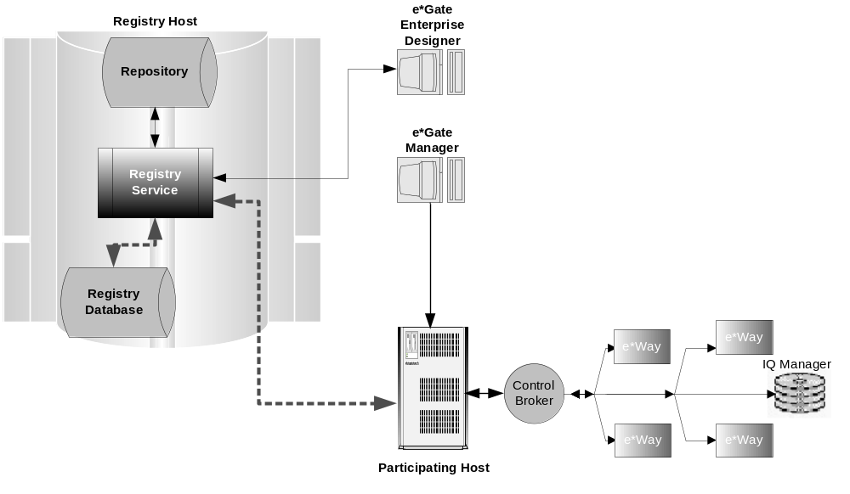
ORIB Architecture

Slide 9
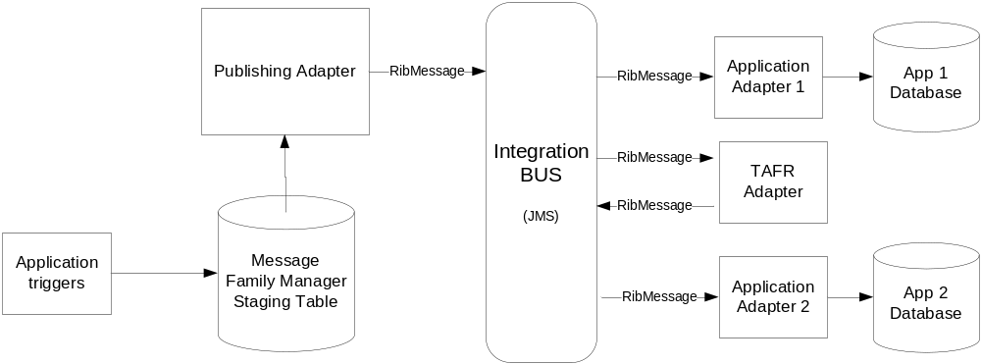
Outbound Eway – Publisher Adapter
  eWay makes a call to the message family manager (RMSMFM_ITEMS.GETNEXT() procedure) to get the message to publish.
  The message family manager will construct the message into Oracle Object and send it to eWay.
  The eWay converts the Oracle Object Type to XML by pubtrans(Eg. ItemsObjectTranslator.java) and publishes a RibMessage, with the message payload;
Notes:
Talk about the Life cycle of a product and explain the below terms
Item
Supplier
Warehouse
Store
Price
Cost
Promotion

Slide 10
Inbound Eway – Subscriber Adapter
Subscriber Adapter ( Inbound eWays)
  Takes the payload from the RibMessage and converts it to Oracle Object Type.
  Makes a call to the appropriate PL/SQL consumer package( eg RMSSUB_XITEMB.CONSUME() with message, message type).
  The Subscriber package converts Oracle Object into PL/SQL variables.
  The records are validated and then inserted into the final tables or staging tables.
Notes:
Talk about the Life cycle of a product and explain the below terms
Item
Supplier
Warehouse
Store
Price
Cost
Promotion

Slide 11
TAFR Adapter
TAFR Adapter
  Transform Address Filter/Router
  Transform between different message formats, (ex: Transfers to Stock Orders);
  Message Routing, depending on the message contents, or conditions that can be checked against the RibMessage Routing info section (ex: item routing per WH);
Notes:
Talk about the Life cycle of a product and explain the below terms
Item
Supplier
Warehouse
Store
Price
Cost
Promotion

Slide 12
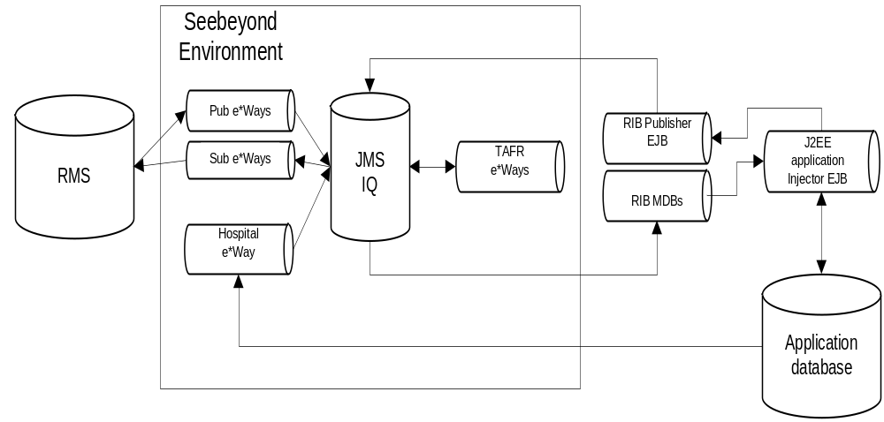
RIB for RPM
Architecture
  ORMS >> Application (ex : ORPM) – MDB
  Application (ex : SIM) >> ORMS - SSB
Notes:
Talk about the Life cycle of a product and explain the below terms
Item
Supplier
Warehouse
Store
Price
Cost
Promotion

Slide 13
New Outbound Adapter
Create the Oracle Type objects which is going to be used for message publishing. Create the Package with ADDTOQ() function, GETNXT() procedure (Eg RMSMFM_TSLSUPPGRP package) Create the Xmlschema file for publishing the message Create the DTD file for publishing the message in XML format Create the pubtrans ( Eg TslsuppgrpObjectTranslator.java) Modify the retek-pub-trans.jar file to include the new pubtrans class file. New Outbound eWay to be built in Egate Modify the component.xml file to include the new eWay, pubtrans. Modify the rib.properties file to include the new eWay. Modify the log4j.xml file to include the new eWay.

Slide 14
Component.xml (Outbound Adapter)
<eway name="ewTSLSuppGrpFromRMS"> <collaboration name="colTSLSuppGrpFromRMS"> <adaptorComponent> <class>com.retek.rib.collab.general.OracleObjectPublisherComponentImpl</class> <messageFamily name="tslsuppgrp"> <translatorClass>com.retek.rib.pubtrans.TslsuppgrpObjectTranslator</translatorClass> <storedProc> <signature>{call RMSMFM_TSLSUPPGRP.GETNXT(?,?,?,?,?,?,?,?)}</signature> </storedProc> </messageFamily> </adaptorComponent> </collaboration> </eway>

Slide 15
rib.properties (Outbound Adapter)
ewTSLSuppGrpFromRMS.colTSLSuppGrpFromRMS.pubMessageCount=1 Which gives how many messages can be published at a time. eway.ewTSLSuppGrpFromRMS.no_event_sleep_millis=120000 The eway specific sleep duration (in milliseconds) if no event to process.

Slide 16
log4j.xml (Outbound Adapter)
Mentioning RIBLog file while processing the messages: <appender name="appender.retek.ewTSLSuppGrpFromRMS.colTSLSuppGrpFromRMS" class="org.apache.log4j.RollingFileAppender"> <param name="File" value="/appl/seebeyond/@environ.name@/RIBLOGS/rib_ewTSLSuppGrpFromRMS.log"/> <param name="MaxFileSize" value="1MB"/> <param name="MaxBackupIndex" value="10"/> <layout class="org.apache.log4j.PatternLayout"> <!--param name="ConversionPattern" value="%d [%t] %-5p %c - %m%n"/--> <param name="ConversionPattern" value="%d{HH:mm:ss,SSS} %c - %m%n"/> </layout> </appender>

Slide 17
log4j.xml (Outbound Adapter)
Mentioning timings Log file while processing the messages: <appender name="appender.timings.ewTSLSuppGrpFromRMS" class="org.apache.log4j.FileAppender"> <param name="File" value="/appl/seebeyond/@environ.name@/RIBLOGS/timings_ewTSLSuppGrpFromRMS.log"/> <layout class="org.apache.log4j.PatternLayout"> <!--param name="ConversionPattern" value="%d [%t] %-5p %c - %m%n"/--> <param name="ConversionPattern" value="%d{yyyy.MM.dd HH:mm:ss.SSS}|ewTSLSuppGrpFromRMS|%m%n"/> </layout> </appender>

Slide 18
log4j.xml (Outbound Adapter)
For eWay logger <logger name="retek.ewTSLSuppGrpFromRMS.colTSLSuppGrpFromRMS" additivity="false"> <appender-ref ref="appender.retek.ewTSLSuppGrpFromRMS.colTSLSuppGrpFromRMS"/> </logger> For timings logger <logger name="timings.ewTSLSuppGrpFromRMS" additivity="false"> <appender-ref ref="appender.timings.ewTSLSuppGrpFromRMS"/> </logger>

Slide 19
New Inbound Adapter
Create the Oracle Type objects which is going to be used for message subscribing. Create the Package with CONSUME() procedure (Eg RMSSUB_TSLXSUPPGRP package) Create the Package ( Eg RMSSUB_TSLXSUPPGRP_VALIDATE) to validate the message data. Create the Package (Eg RMSSUB_TSLXSUPPGRP_SQL) to persist the RIB message data to corresponding tables. Create the Xmlschema file for subscribing the message Create the DTD file for subscribing the message in XML format New Outbound eWay to be built in Egate Modify the component.xml file to include the new inbound eWay. Modify the rib.properties file to include the new inbound eWay. Modify the log4j.xml file to include the new inbound eWay.

Slide 20
Component.xml (Inbound Adapter)
<eway name="ewTSLXSuppGrpToRMS"> <collaboration name="colTSLXSuppGrpToRMS"> <adaptorComponent> <class>com.retek.rib.collab.general.OracleObjectSubscriberComponentImpl</class> <messageFamily name="tslxsuppgrp"> <storedProc> <signature>{call RMSSUB_TSLXSUPPGRP.CONSUME(?,?,?,?)}</signature> </storedProc> <messageType name="XSUPPGRPCRE"> <oracleObject>RIB_TSLXSUPPGRPDESC_REC</oracleObject> </messageType> <messageType name="XSUPPGRPMOD"> <oracleObject>RIB_TSLXSUPPGRPDESC_REC</oracleObject> </messageType> <messageType name="XSUPPGRPDEL"> <oracleObject>RIB_TSLXSUPPGRPREF_REC</oracleObject> </messageType> <messageType name="XSUPPGRPDTLCRE"> <oracleObject>RIB_TSLXSUPPGRPDTLDESC_REC</oracleObject> </messageType> <messageType name="XSUPPGRPDTLDEL"> <oracleObject>RIB_TSLXSUPPGRPDTLREF_REC</oracleObject> </messageType> </messageFamily> </adaptorComponent> </collaboration> </eway>

Slide 21
rib.properties (Inbound Adapter)
eway.ewTSLXSuppGrpToRMS.no_event_sleep_millis=120000 The eway specific sleep duration (in milliseconds) if no event to process

Slide 22
log4j.xml (Inbound Adapter)
<appender name="appender.retek.ewTSLXSuppGrpToRMS.colTSLXSuppGrpToRMS" class="org.apache.log4j.RollingFileAppender"> <param name="File" value="/appl/seebeyond/@environ.name@/RIBLOGS/rib_ewTSLXSuppGrpToRMS.log"/> <param name="MaxFileSize" value="1MB"/> <param name="MaxBackupIndex" value="10"/> <layout class="org.apache.log4j.PatternLayout"> <!--param name="ConversionPattern" value="%d [%t] %-5p %c - %m%n"/--> <param name="ConversionPattern" value="%d{HH:mm:ss,SSS} %c - %m%n"/> </layout> </appender>

Slide 23
log4j.xml (Inbound Adapter)
For eWay logger <logger name="retek.ewTSLXSuppGrpToRMS.colTSLXSuppGrpToRMS" additivity="false"> <appender-ref ref="appender.retek.ewTSLXSuppGrpToRMS.colTSLXSuppGrpToRMS"/> </logger> For timings logger <logger name="timings.ewTSLXSuppGrpToRMS" additivity="false"> <appender-ref ref="appender.timings.ewTSLXSuppGrpToRMS"/> </logger>

Slide 24
New Outbound from RPM
Create new XSD & DTD files as per the message structure. Use the XSD file to prepare the Payload java files by using castor 0.9.5.2. Castor tool would not extend the PayloadImpl class for Payload java and we need to change in java file. Eg: public class TSLZone extends com.retek.rib.binding.payload.PayloadImpl implements java.io.Serializable {} It needs serialVersionUID for the Payload java and we need to add in java file as below: Eg: static final long serialVersionUID = 200710190000L; It is in the format of the class compiled date: Year -2007 Month-10 Date -19 The payload java files should be compiled and will be used in retek-payload-typed.jar file which will be deployed in the following location: RIB for RPM - /appl/oracle/as/10.1.3/j2ee/hsctst09-rib-rpm/applications/rib-rpm/lib RPM - /appl/oracle/as/10.1.3/j2ee/hsctst09-rpm/applications/rpm12/lib RPM Batch - /appl/oracle/as/10.1.3/j2ee/hsctst09-rpm/rpm-batch/lib

Slide 25
Retek-payload-typed.jar – payload.properties file
Message types of New Outbound msg should be updated in payload.properties file. Which is in retek-payload-typed.jar file. Eg: Zone Maintenance Messages ZONEMNT.ZONEGRPCRE=com.retek.rib.binding.payload.TSLZoneGroupDesc ZONEMNT.ZONEGRPMOD=com.retek.rib.binding.payload.TSLZoneGroupDesc ZONEMNT.ZONEGRPDEL=com.retek.rib.binding.payload.TSLZoneGroupRef

Slide 26
Retek-payload-typed.jar – Payload classes
ZONEMNT is a family name ZONEGRPCRE, ZONEGRPMOD, ZONEGRPDEL are message types. com.retek.rib.binding.payload.TSLZoneGroupDesc - Payload class for CRE, MOD messages. com.retek.rib.binding.payload.TSLZoneGroupRef – Payload class for DEL message.

Slide 27
RIB for RPM application – rib.properties
RIB for RPM application: rib.properties file at /appl/oracle/as/10.1.3/j2ee/hsctst09-rib-rpm/rib-rpm to include the Family & Topic Name where to publish. Eg: ZONEMNT=etZoneMntFromRPMZONEGRPMERCHLVL=etZoneGrpMerchLvlFromRPM

Slide 28
RIB for RPM – rib-config.properties
rib-config.properties file at /appl/oracle/as/10.1.3/j2ee/hsctst09-rib-rpm/rib-rpm to include Log4j details. Eg: log4j.8=ZoneMnt,PUBLISHER log4j.9=ZoneGrpMerchLvl,PUBLISHER

Slide 29
RIB for RPM – log4j.xml
log4j.xml file at /appl/oracle/as/10.1.3/j2ee/hsctst09-rib-rpm/rib-rpm to include log file details with Timings Appender, RIB appender: Eg: <!--Timings Appender for PUB: aZoneMnt--> <appender name="appender.rib.pub.timings.zonemnt" class="org.apache.log4j.FileAppender"> <param name="File" value="/appl/oracle/as/10.1.3/j2ee/hsctst09-rib-rpm/log/rib-rpm/timings_zonemnt_pub.log"/> <!--param name="MaxFileSize" value="2048KB"/--> <!--param name="MaxBackupIndex" value="1"/--> <layout class="org.apache.log4j.PatternLayout"> <param name="ConversionPattern" value="%d{yyyy.MM.dd HH:mm:ss.SSS}|ZoneMntToApp|%t||%m%n"/> </layout> </appender>

Slide 30
RIB for RPM – log4j.xml
<!--RIB Appender for PUB: aZoneMnt--> <appender name="appender.publisher.zonemnt" class="org.apache.log4j.RollingFileAppender"> <param name="File" value="/appl/oracle/as/10.1.3/j2ee/hsctst09-rib-rpm/log/rib-rpm/rib_zonemnt_pub.log"/> <param name="MaxFileSize" value="2048KB"/> <param name="MaxBackupIndex" value="1"/> <layout class="org.apache.log4j.PatternLayout"> <param name="ConversionPattern" value="%d [%t] %-5p %C - %m%n"/> </layout> </appender>

Slide 31
RIB for RPM – log4j.xml
Also add the Timings Logger & RIB Logger details in log4j.xml as below <!--Timings Logger for PUBLISHER: aZoneMnt--> <logger name="rib.pub.timings.zonemnt" additivity="false"> <appender-ref ref="appender.rib.pub.timings.zonemnt"/> </logger> <!--RIB Logger for PUBLISHER: aZoneMnt--> <logger name="retek.publisher.zonemnt" additivity="true"> <appender-ref ref="appender.publisher.zonemnt"/> </logger>

Slide 32
Classes in RPM Helps RIB
RPMServerContext This is the primary class for managing transactions, JMS sessions and hibernate sessions. RibTransactionManager This class manages the RIB transactions with in RPM. RPMRibPublishingCoreServiceImpl This helps to build payloads into Accumulator based on RIB transaction id. RibPayloadAccumulator This helps to build set of payloads based on RIB transaction id till MAX_DETAILS_TO_PUBLISH in RPM_RIB_PROPERTIES table. PublishStagedPayloadIterator This helps to set values from payload tables into payload object which is going to get published. BatchPayloadDeleteOperation This class helps to delete records from Payload tables.

Slide 33
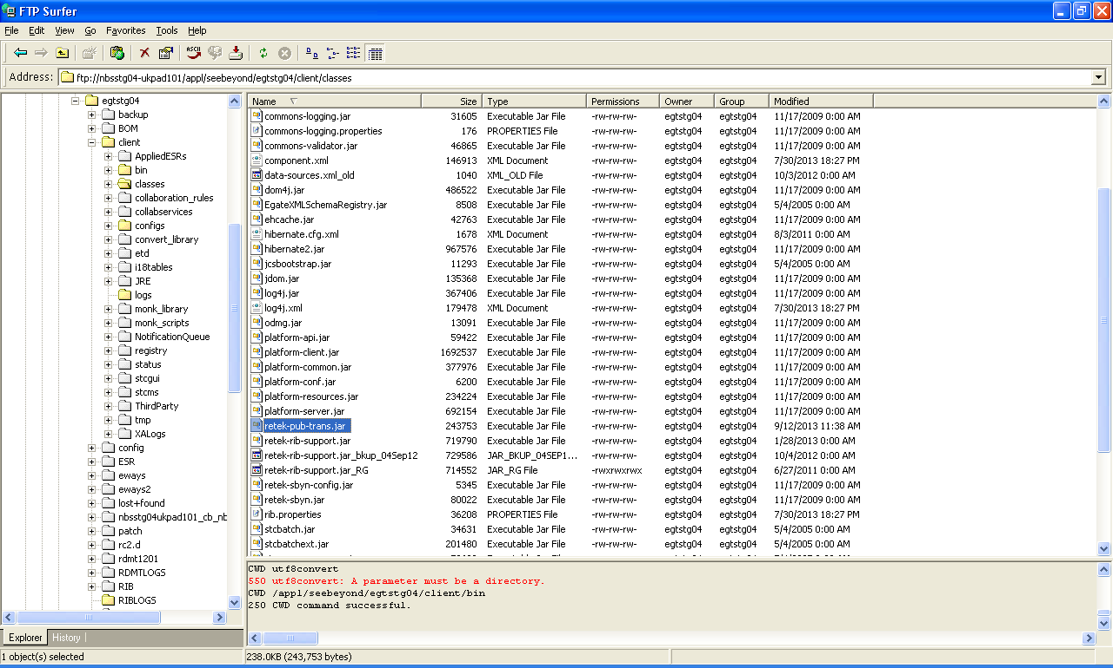
RIB Jars
Notes:
Talk about the Life cycle of a product and explain the below terms
Item
Supplier
Warehouse
Store
Price
Cost
Promotion

Slide 34
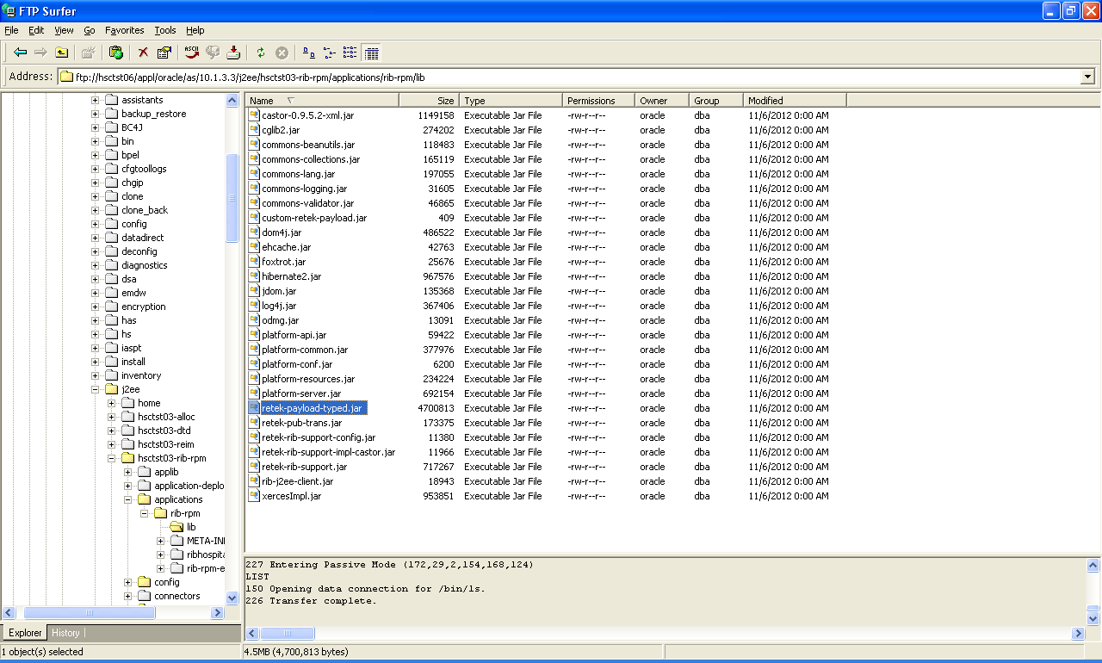
RIB for RPM Jars
Notes:
Talk about the Life cycle of a product and explain the below terms
Item
Supplier
Warehouse
Store
Price
Cost
Promotion

Slide 35
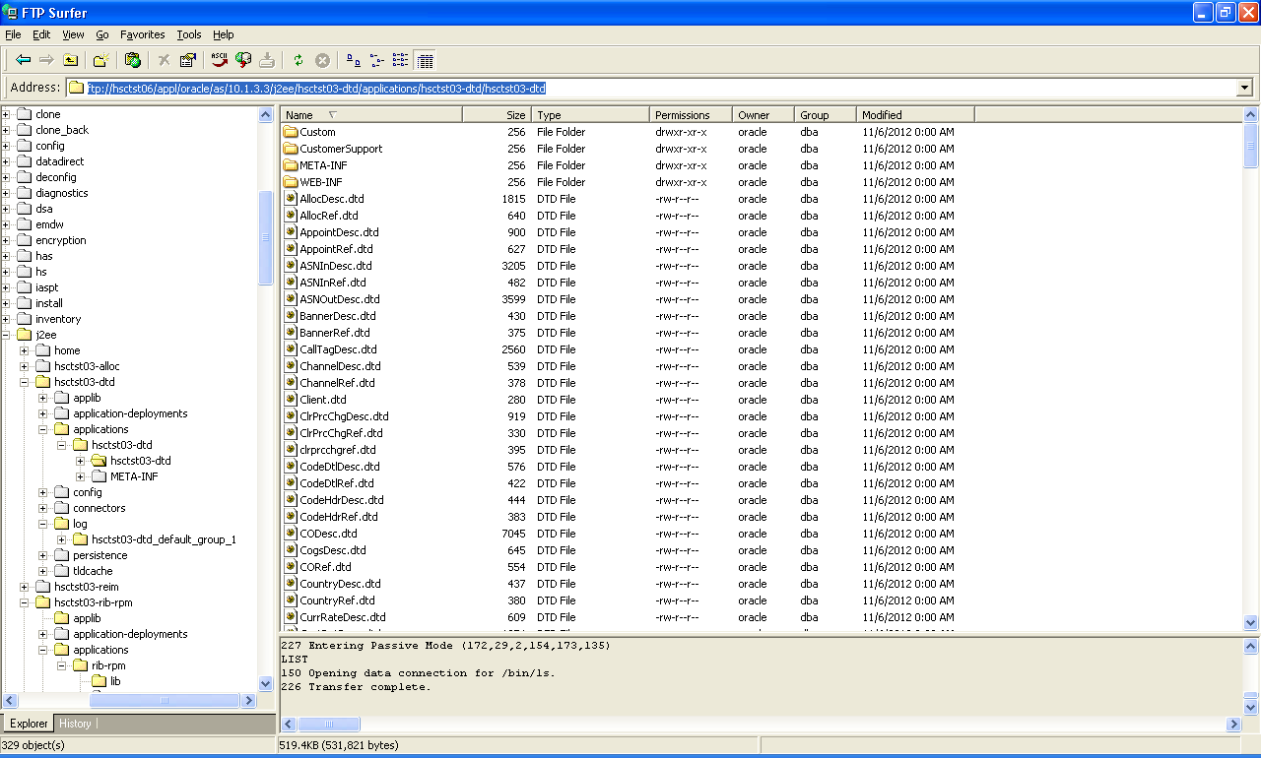
RIB DTD Schema files
Notes:
Talk about the Life cycle of a product and explain the below terms
Item
Supplier
Warehouse
Store
Price
Cost
Promotion

Slide 36
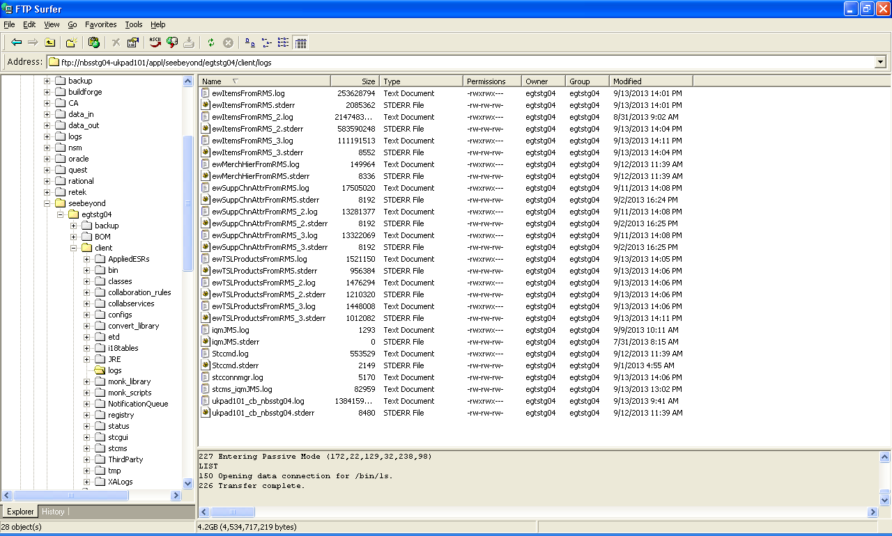
RIB Logs
Notes:
Talk about the Life cycle of a product and explain the below terms
Item
Supplier
Warehouse
Store
Price
Cost
Promotion

Slide 37
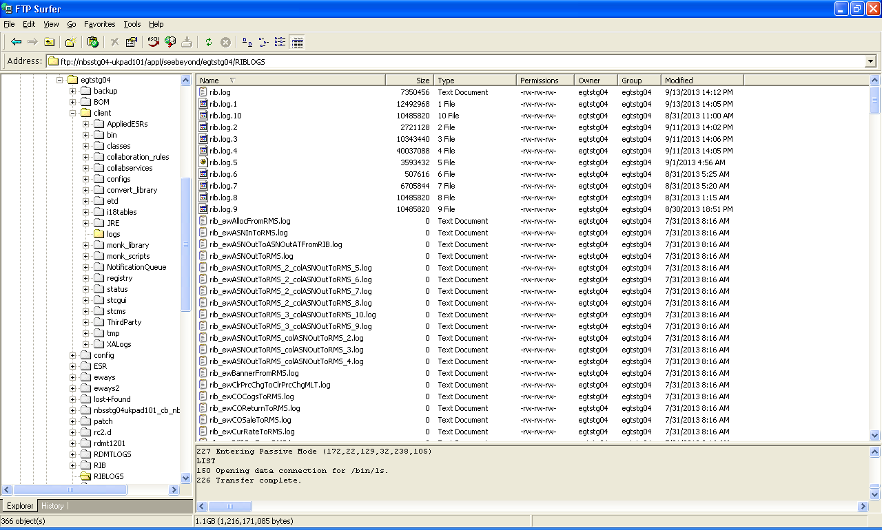
RIB Logs
Notes:
Talk about the Life cycle of a product and explain the below terms
Item
Supplier
Warehouse
Store
Price
Cost
Promotion

Slide 38
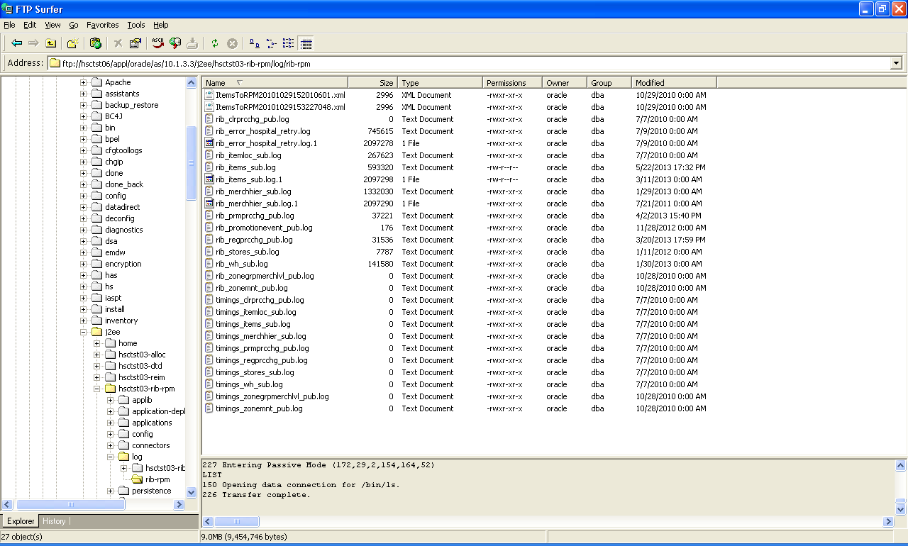
RIB for RPM Logs
Notes:
Talk about the Life cycle of a product and explain the below terms
Item
Supplier
Warehouse
Store
Price
Cost
Promotion

Slide 39
RIB Hospital
RIB Hospital Tables
  RIB_MESSAGE
  RIB_MESSAGE_FAILURE
Notes:
Talk about the Life cycle of a product and explain the below terms
Item
Supplier
Warehouse
Store
Price
Cost
Promotion

Slide 40
Thankyou
Pls provide your valuable Feedback at http://cdm

